Slide 1

Child Tracking System
2110030291 - Shaik Farhaan Ali
2110030295 - K.V.Suhas
2110030323 - P Rama Kowshik
2110030377 - Jaya Surya

Slide 2
Develop an app which allows parents to follow their children's last GPS position and activities from anywhere in the world, thus keeping a full track of their whereabouts.
Nowadays, parents are worried about children activities and their safety.
Children are always curious, this may have negative influence. So keeping an eye on their activities is must.
Due to increase in child missing cases, parents need to track their location.
During child missing cases, most can be solved within 24 hours with child tracking.
Research and analysis:
https://indianexpress.com/article/technology/tech-news-technology/over-three-quarter-of-indians-want-to-monitor-their-childrens-activity-online-nortonlifelock-8047179/
https://riseuplabs.com/blog/parental-control-software/
PROBLEM STATEMENT AND DOMAIN

Slide 3
There are some existing solutions which are based on hardware products which must be installed with the knowledge of child and is complicated to be set up or to delicate to be handled by kids.
And there are applications which provides only location of the child or only activities of the child but not both combined.
Some existing Child tracking apps which only track location:
https://famisafe.wondershare.com/mobile-tracker/child-phone-tracker-apps.html
Can also find some pros and cons of the existing child tracking systems:
https://riseuplabs.com/blog/parental-control-software/
EXISTING SOLUTION

Slide 4
What is the technique?
We are using starUML, XML, MYSQL, and JAVA language.
How is it suitable for your application?
starUML is used for use case diagrams for application.
We use MYSQL to store the entered data back-end.
We use XML and JAVA for front-end webpage design.
What do you know about the solution of it using the proposed design method?
We use starUML to draw use case diagrams to understand the algorithm easily.
The solution we have come up with is that XML and JAVA helps to create dynamic webpage easily compared to other languages.
Also storing data in database using MYSQL is better than saving in files.
PROPOSED ALGORITH DESIGN TECHINIQUE

Slide 5

PROPOSED SOLUTION
SOLUTION:
We want to create a app(child app) which needs only the child phone number , location permission and mail details without any subscription charges or personal details.
And also there will be a app(Parent app) gets all the information of child activities and child location up to date.
And to monitor the child our app takes the gmail details during sign up and access the account details by OTP.
The server receives users’ location and alerts parents if they are in the same location.
Here, MySQL is the database used for maintaining the record of the child’s activities along with PHP.
SRS DOCUMENTATION
https://docs.google.com/document/d/15obKAXYOUiLfAghEEUn0q3vDozFpPA_5rNFeKTnFdf4/edit?usp=sharing

Slide 6
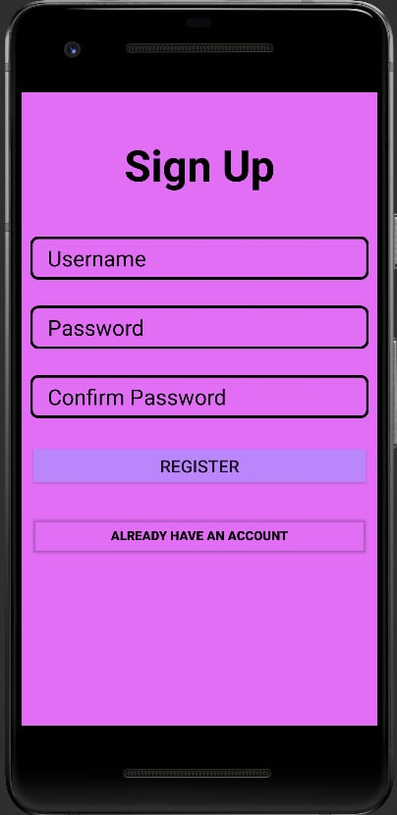
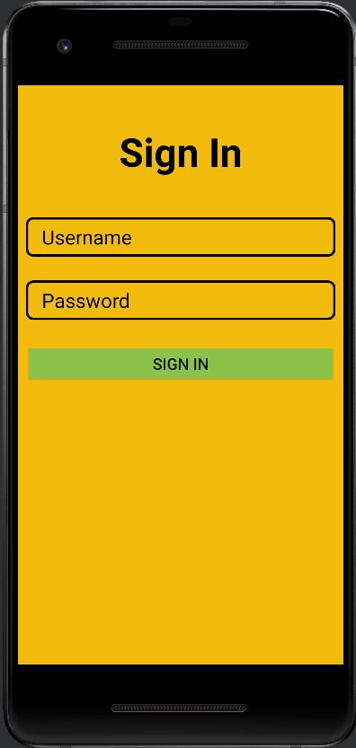
Working Progress

Slide 7
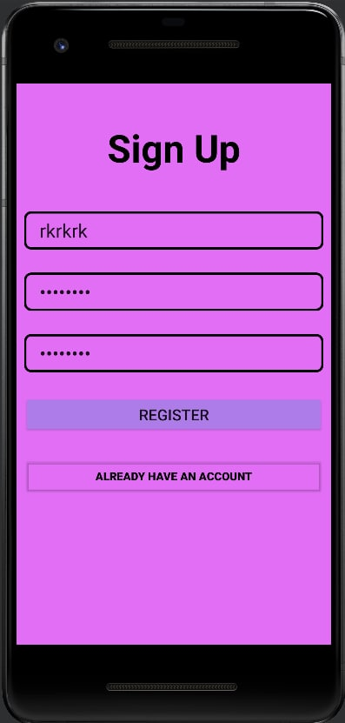
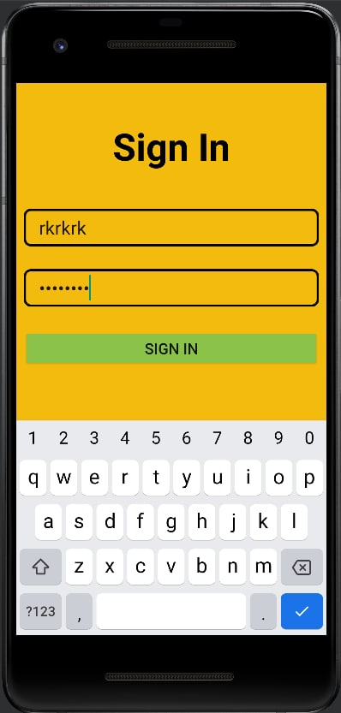
Working Progress

Slide 8
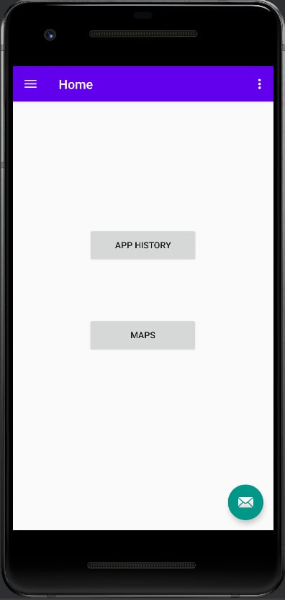
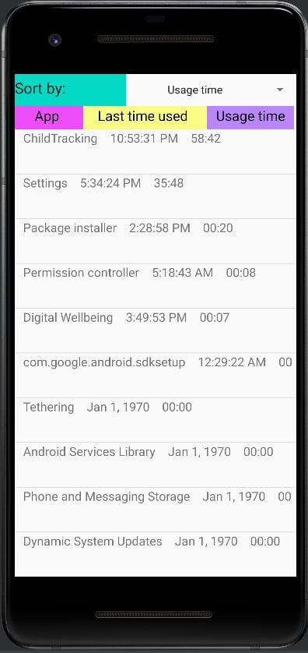
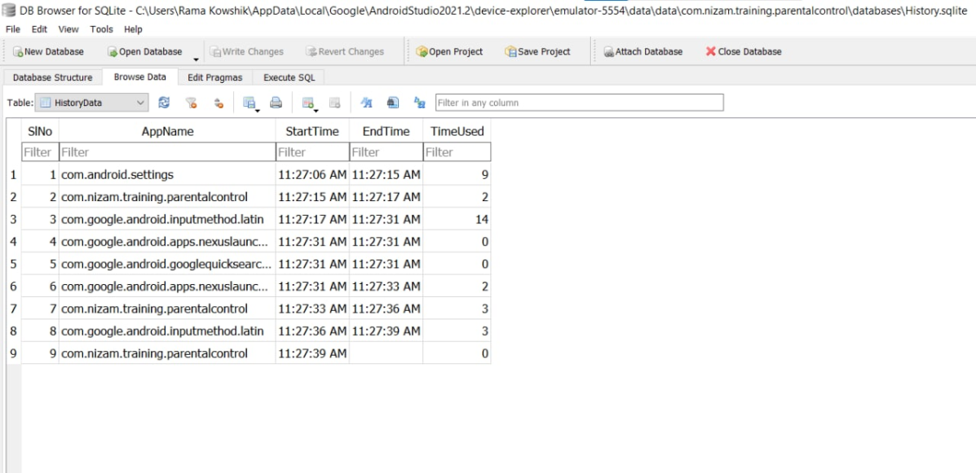
Working Progress

Slide 9
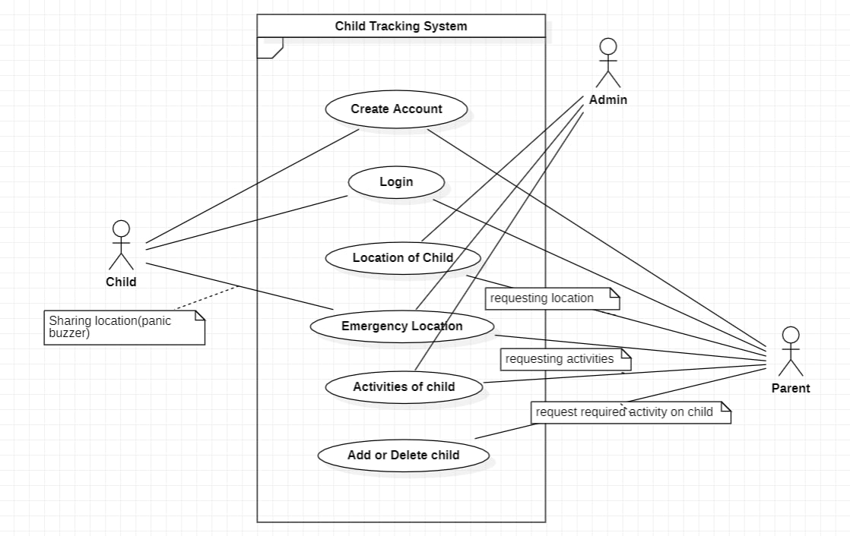
Use Case Diagram
USE CASE DIAGRAM

Slide 10
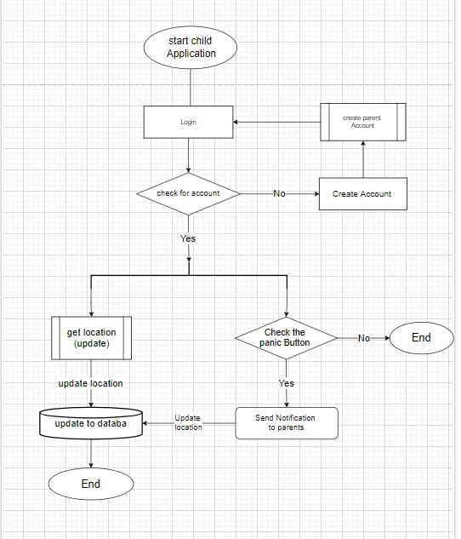
FLOW CHART
DIAGRAM

Slide 11
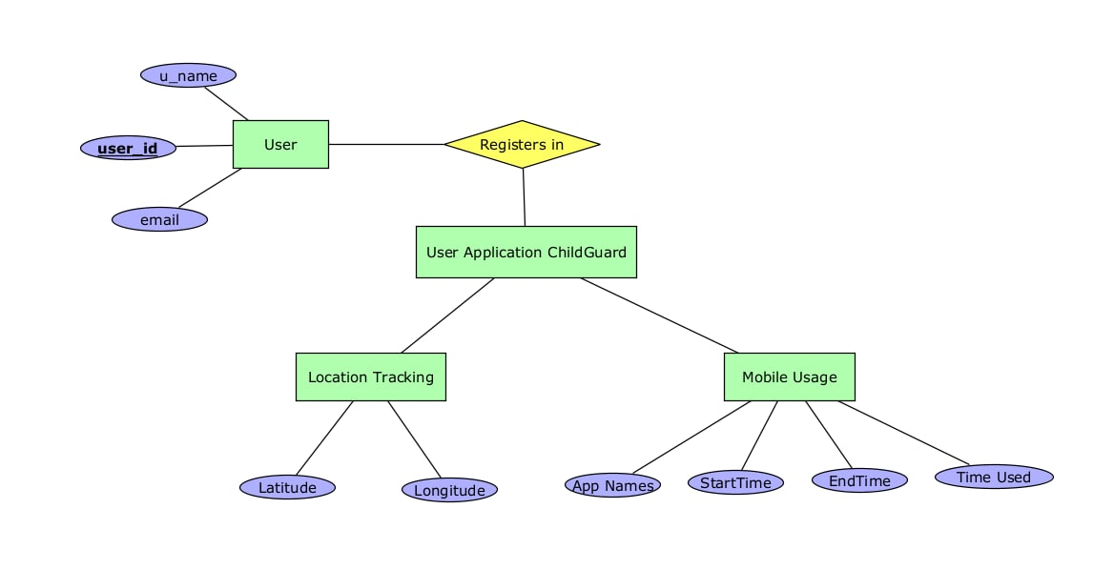
ER DIAGRAM

Slide 12
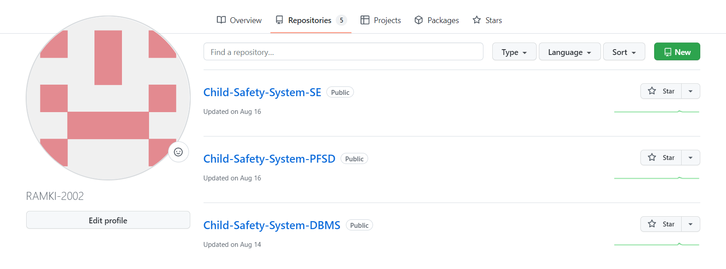
We have created a repository with the project title
GITHUB SETUP
https://github.com/RAMKI-2002
https://github.com/suhas-02
https://github.com/Farhaan04
https://github.com/jayasurya377

Slide 13
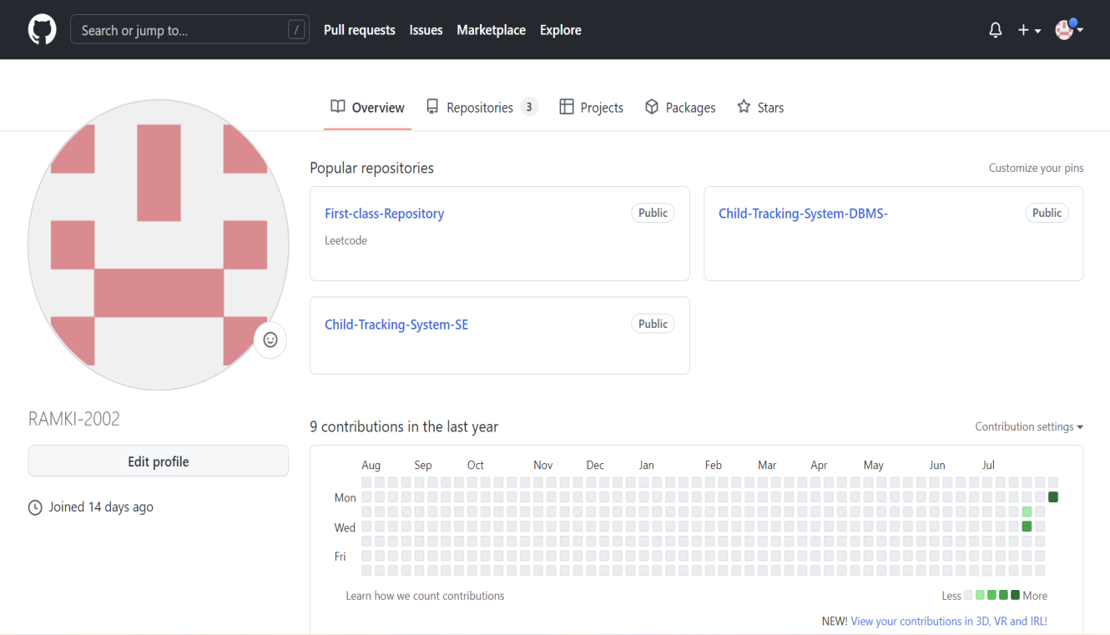
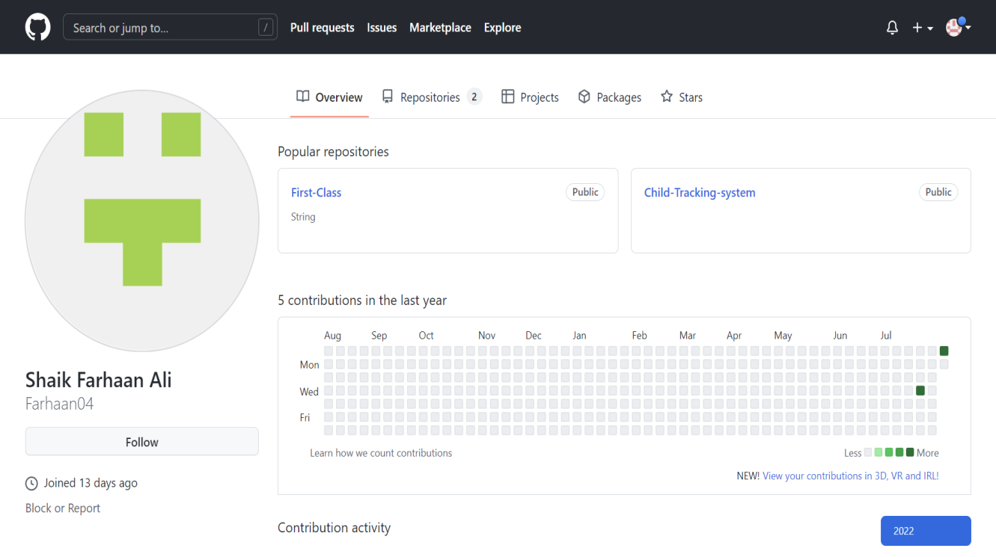
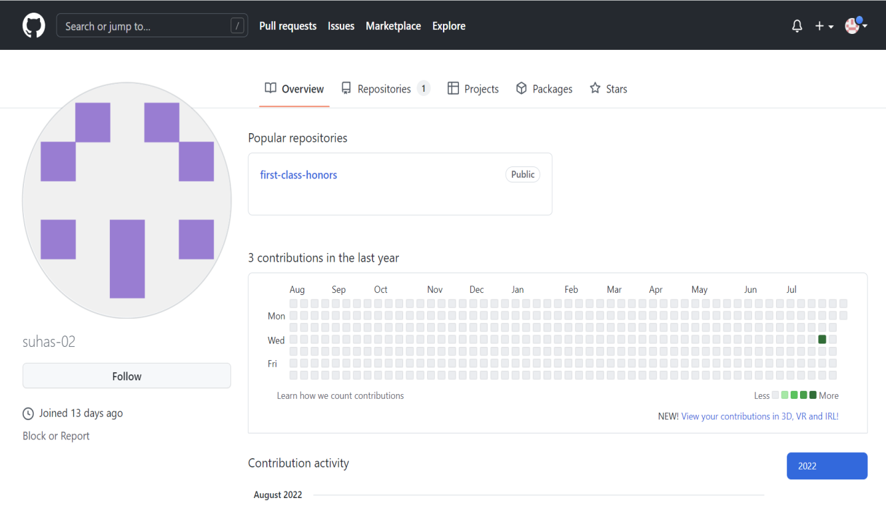
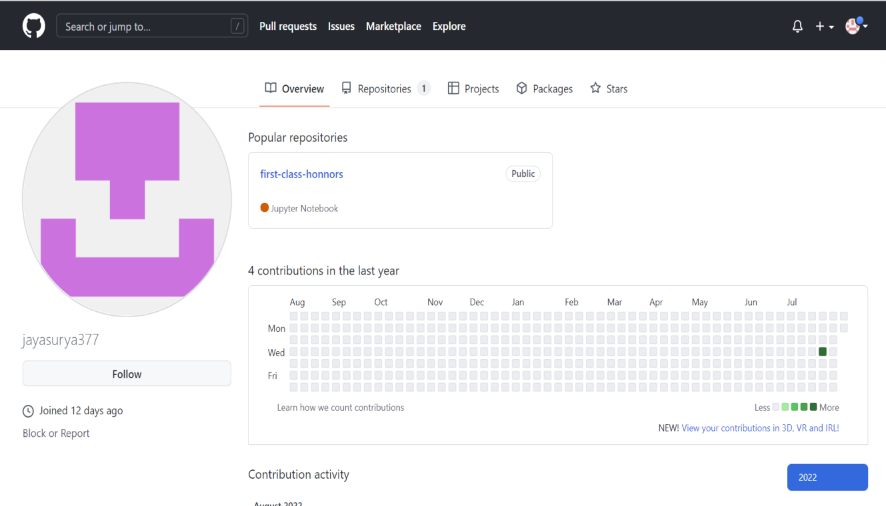

Slide 14
WORK ALLOCATION
2010030291-BACK END
2110030295-FRONT END
2010030323-DATA BASE
2010030377-REASEARCH AND GATHERING INFO

Slide 15



